Slide 1
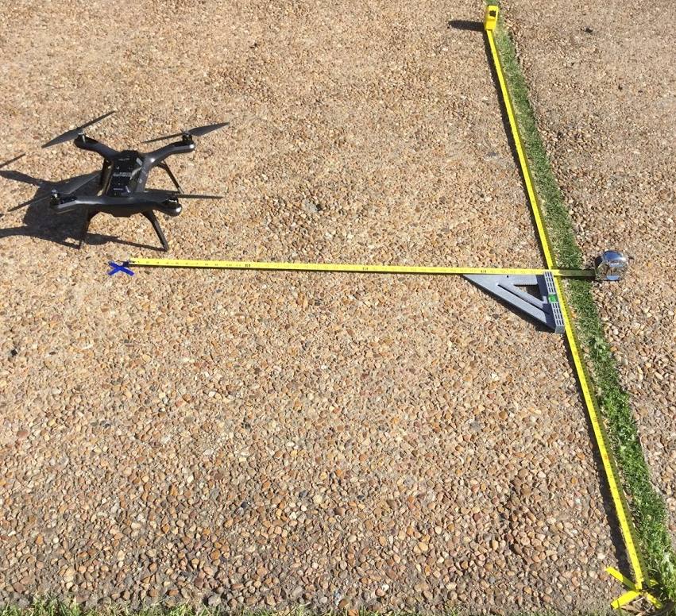
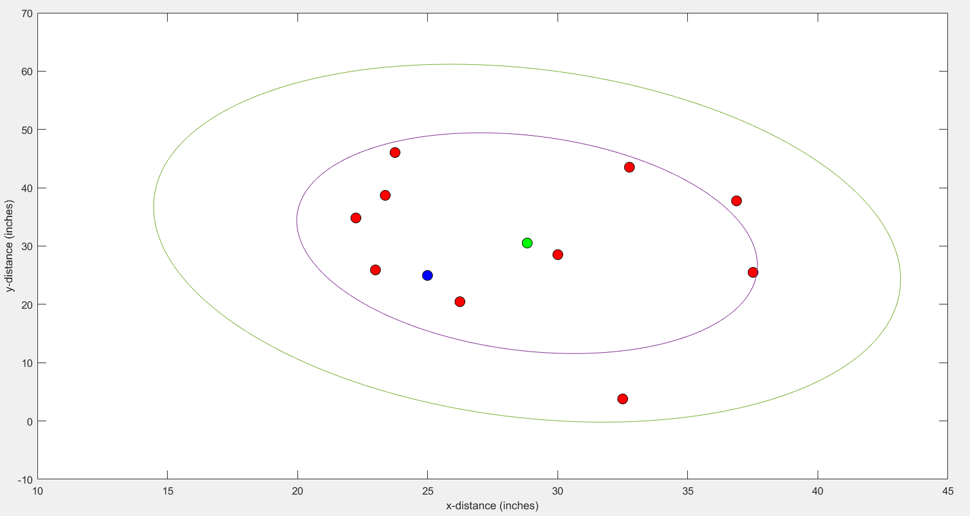

a.
Autonomous Landing without Sensor Platform
Landing Location
Goal location (25,25)
Origin of the coordinate system (0,0)
b.
Landing Location
Goal Location
Mean
$1^{st}$ Variance Ellipse
$2^{nd}$ Variance Ellipse

